Slide 1
Using Data in the Classroom: A Guide for College-level Instructors
ICPSR Summer Program, Blalock Lecture
July 10, 2013
Lynette Hoelter
lhoelter@umich.edu

Slide 2
Presentation Outline:
What is data?
Why use data?
When should I use data?
How can I use data?
“Content” courses
Research Methods courses (not statistics)
Where can I find data and tools?

Slide 3
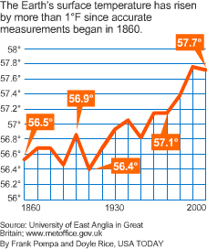
What is “data”?
For this presentation, “data” refers to summary information presented numerically in graphs, charts, or tables and the underlying survey results.
Some of the suggestions here also take advantage of the ICPSR meta-data (the data about the data).

Slide 4
Why use data? (In ANY course)
Applies course content to “real life”
Promotes more active learning
piques student interest
makes content more memorable
Demonstrates how social scientists work
Builds quantitative literacy in a non-threatening context
Provides JOB SKILLS
Notes:
“‘Statistical literacy, quantitative literacy, numeracy – under the hood, it is what do we want people to be able to do: Read tables and graphs and understand English statements that have numbers in them. That’s a good start,’ said Milo Schield, a professor of statistics at Augsburg College and a vice president of the National Numeracy Network.
Shield was dismayed to find that, in a survey of his new students, 44 percent could not read a simple 100 percent row table and about a quarter could not accurately interpret a scatter plot of adult heights and weights.”
Chandler, Michael Alison. What is Quantitative Literacy?, Washington Post, Feb. 5, 2009

Slide 5
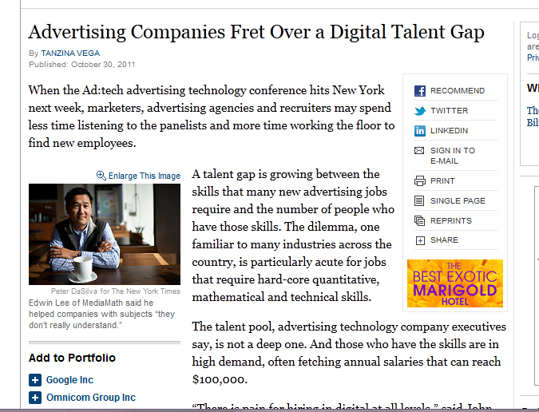
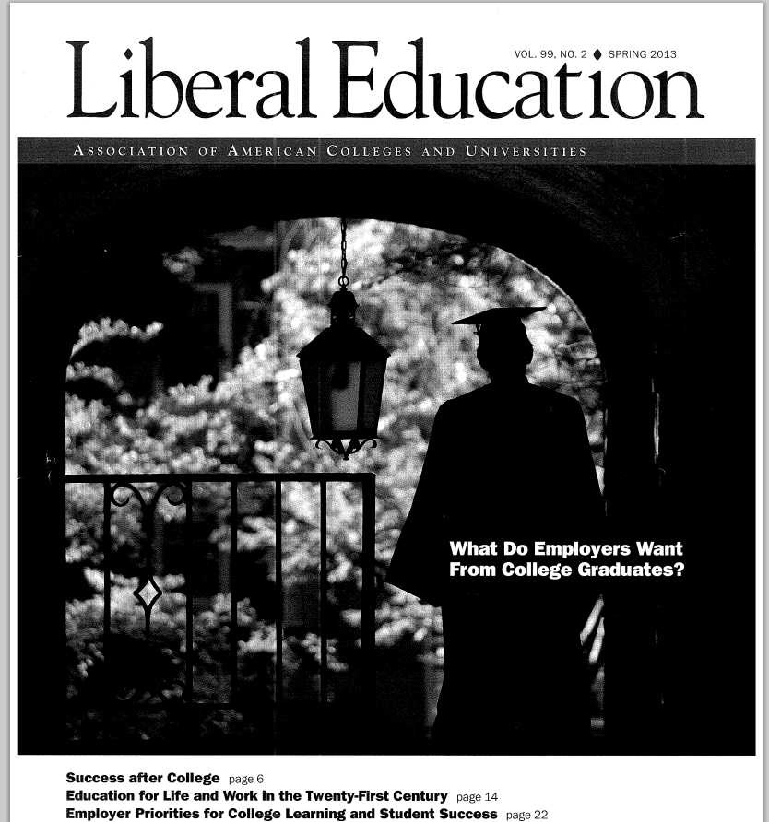
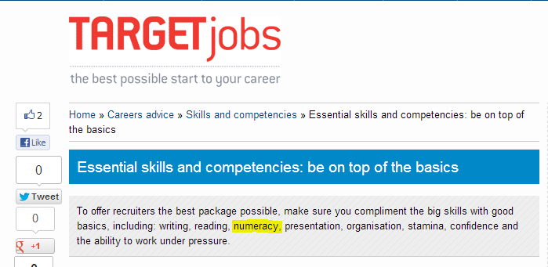
“…practices are clearly seen by employers as having potential for improving the quality of college learning. . . . The top practice they endorse is research. Employers believe that students who are challenged to ‘develop research questions in their fields’ and who can conduct “evidence-based analysis’ will be well positioned to succeed in the workplace.” (p. 10)
Skills most highly valued include: critical thinking, communicate clearly, and complex problem solving..

Slide 6
Quantitative Literacy
Skills learned and used within a context
Reading and interpreting tables or graphs and to calculating percentages
Working within a scientific model (variables, hypotheses, etc.)
Understanding and critically evaluating numbers presented in everyday lives
Evaluating and creating arguments based on data
Knowing what kinds of data might be useful in answering particular questions
Notes:
Drawn from a rubric produced by sociologists in CCLI project – based on AAC&U rubric for quant literacy.
Critical for a democratic society (Steen 2001)
Informed citizenry – must be able to make sense of information coming from multiple sources.
Use of evidence in making decisions and evaluating arguments.

Slide 7
Importance of QL
Availability of information requires ability to make sense of information coming from multiple sources
Use of evidence is critical in making decisions and evaluating arguments
Understanding information is prerequisite for fully participating in a democratic society
Employers value these skills

Slide 8
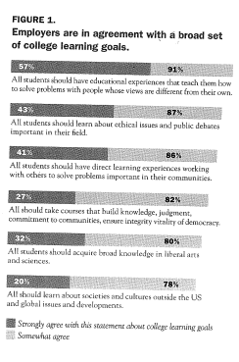
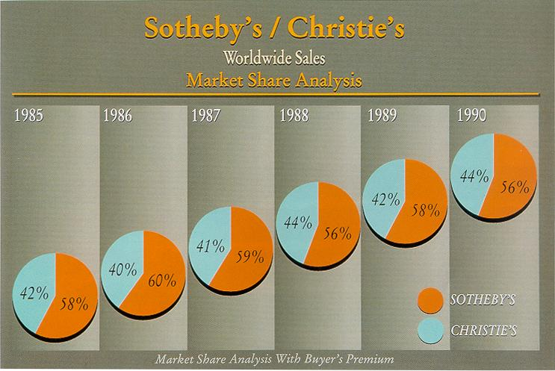
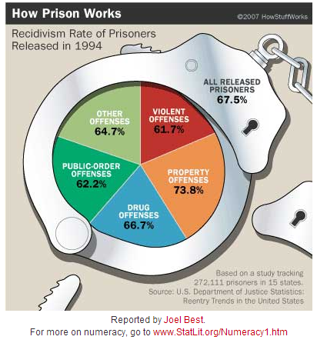
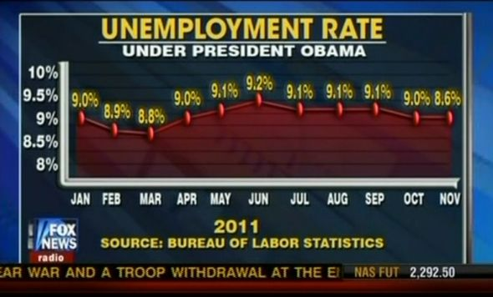
Importance of QL (con’t)
Knowledge to question graphics like these:

Slide 9
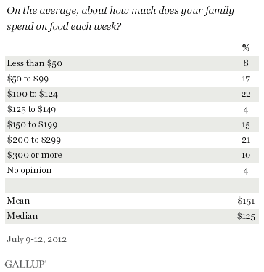
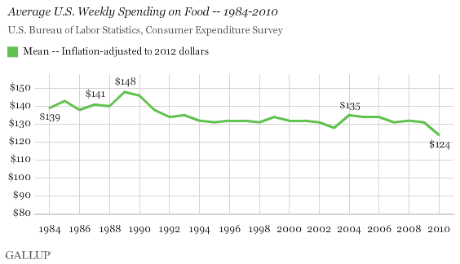
When to Include Data
ALL the time!!!!! (Or at least whenever you feel like it…Seriously!)

Slide 10
Typical Ways to Incorporate Data
Start class with a data-based news article
Have students interpret charts/graphs from popular media and critique news articles
Require empirical evidence to support claims in written work
Question banks and exercises allow students to work with surveys and the resulting data
Have students collect data – even in-class polls!
Engage students by having them find maps, graphs, or other data that provide examples of course content

Slide 11
Research Methods Using ICPSR Tools
Online analysis
Bibliography
Exploring Data Through Research Literature
Search/Compare variables tool
Crosstab Assignment Builder
Political Science: SETUPS, ICSC
Using documentation

Slide 12
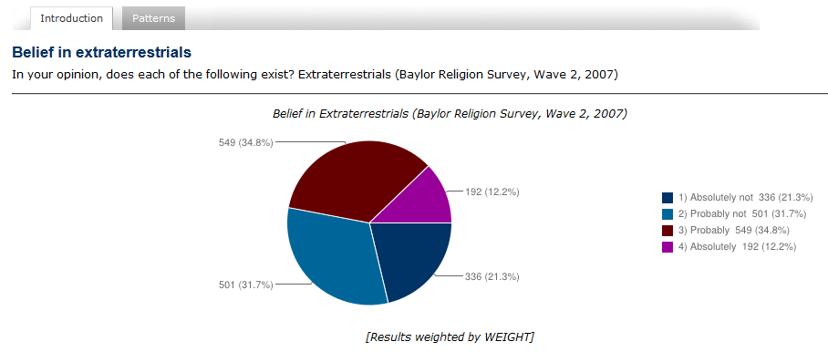
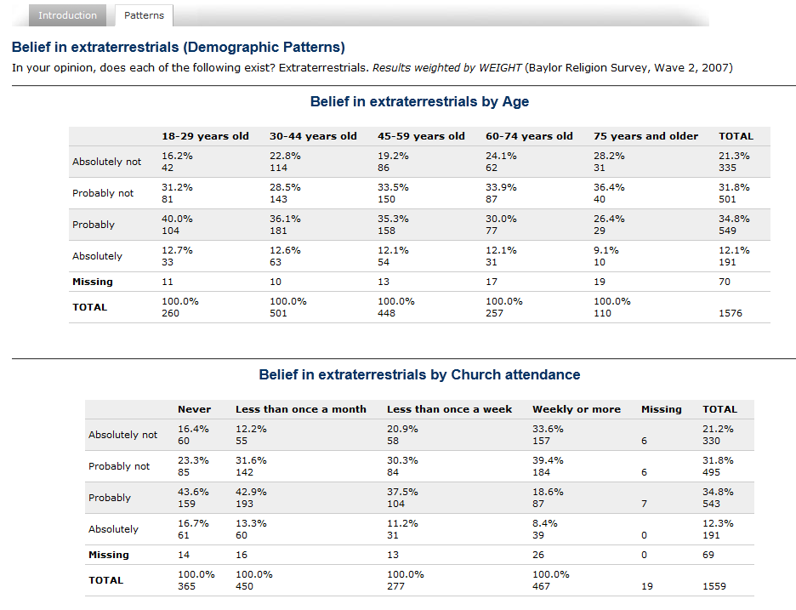
Tools for Faculty
“Quick facts”
Public opinion
Visualizing data
Interesting statistics
Quantitative news blogs
Pre-made exercises, pedagogical examples
Collections of resources

Slide 13
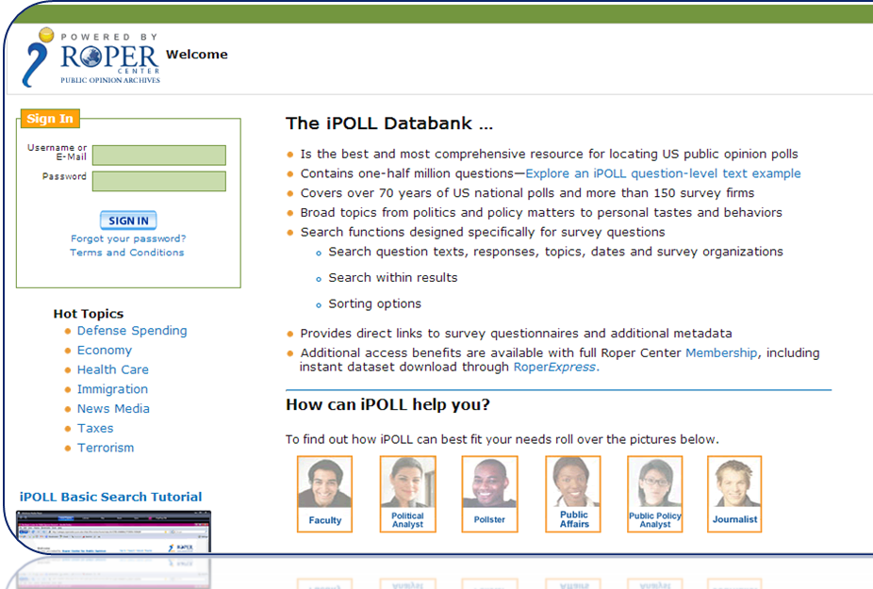
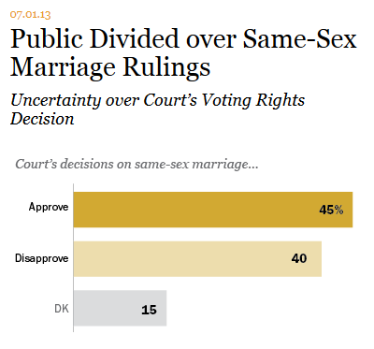
Public Opinion Data
Roper Center for Public Opinion Research www.ropercenter.uconn.edu
Gallup: www.gallup.com
NORC reports & data: www.norc.org/Research/DataFindings
Pew Research Center: www.pewresearch.org
Fact Tank, Reports, Datasets, Interactives

Slide 14
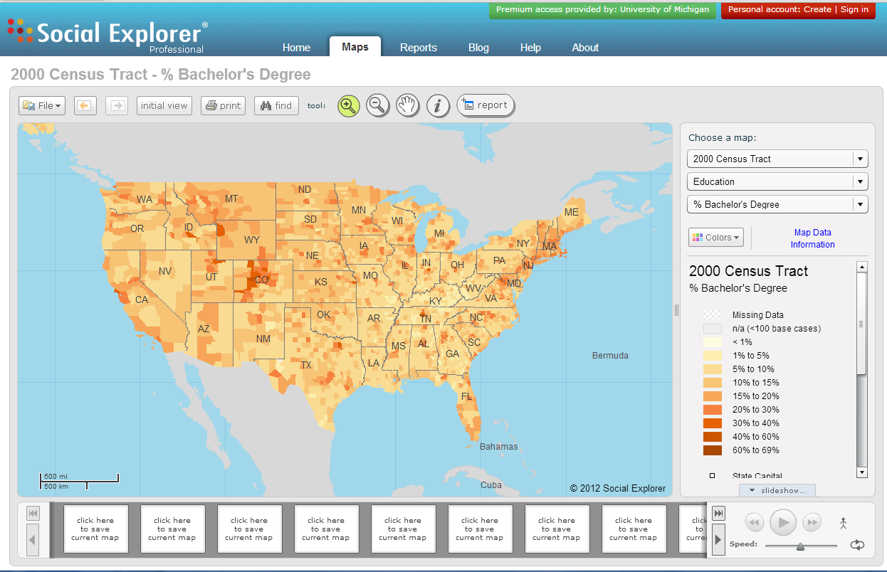
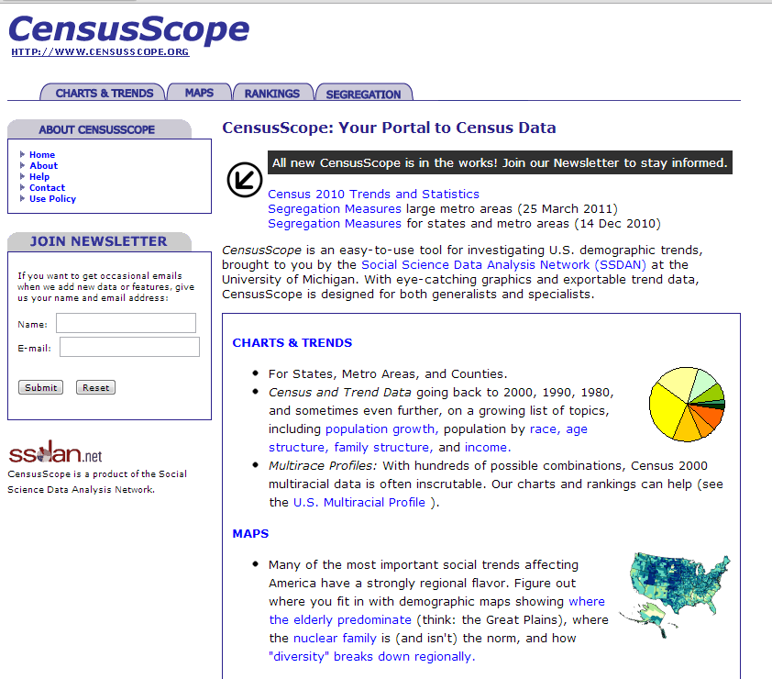
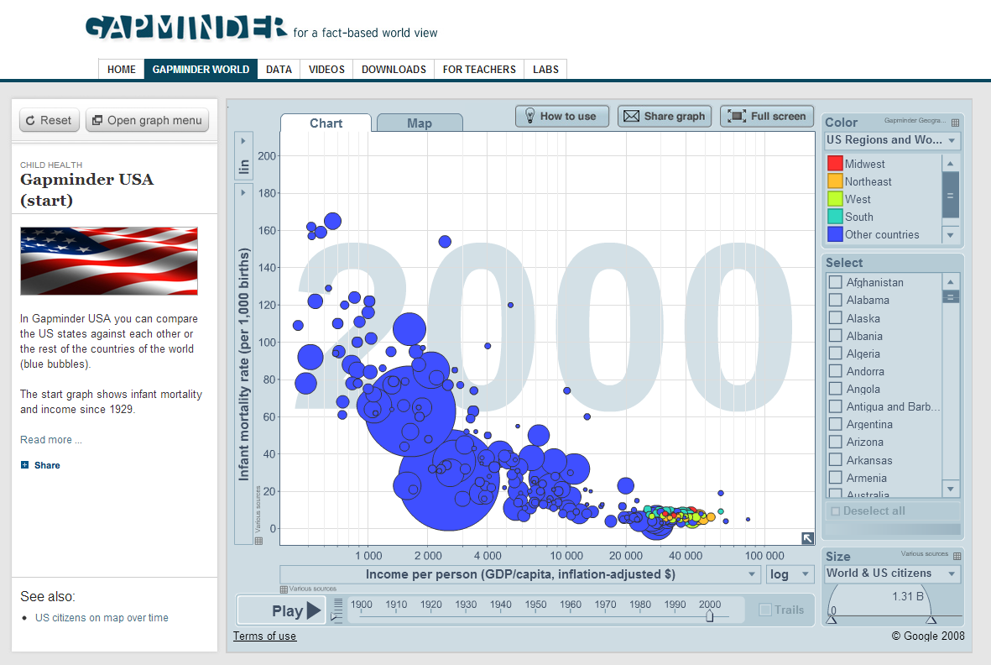
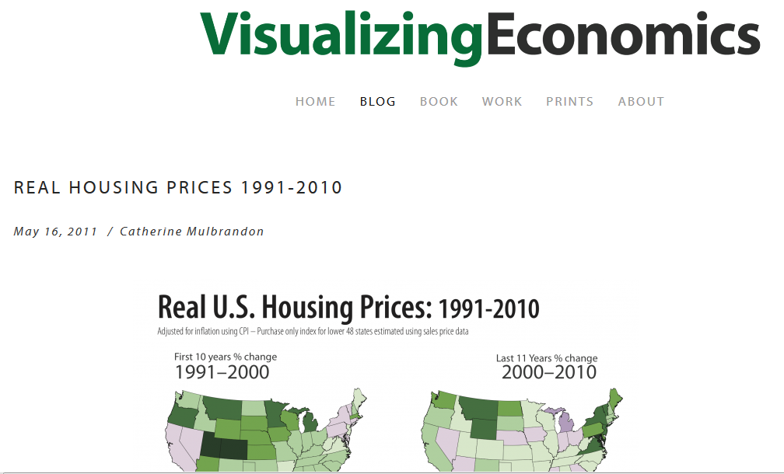
Visualizing Data
Social Explorer
CensusScope
Gapminder
Visualizing Economics

Slide 15
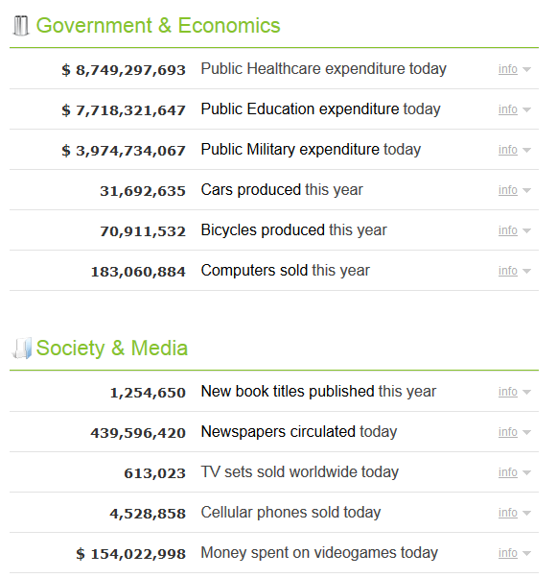
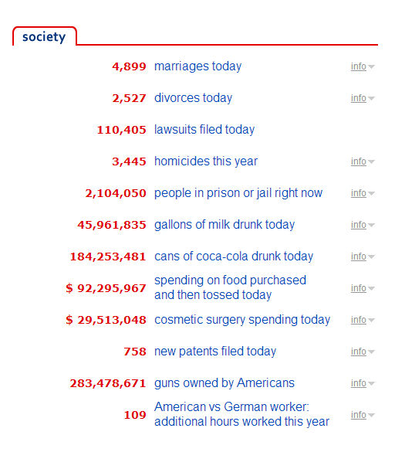
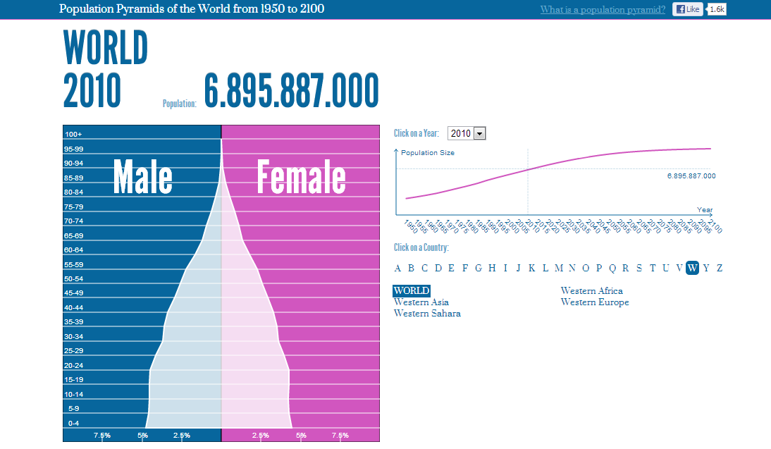
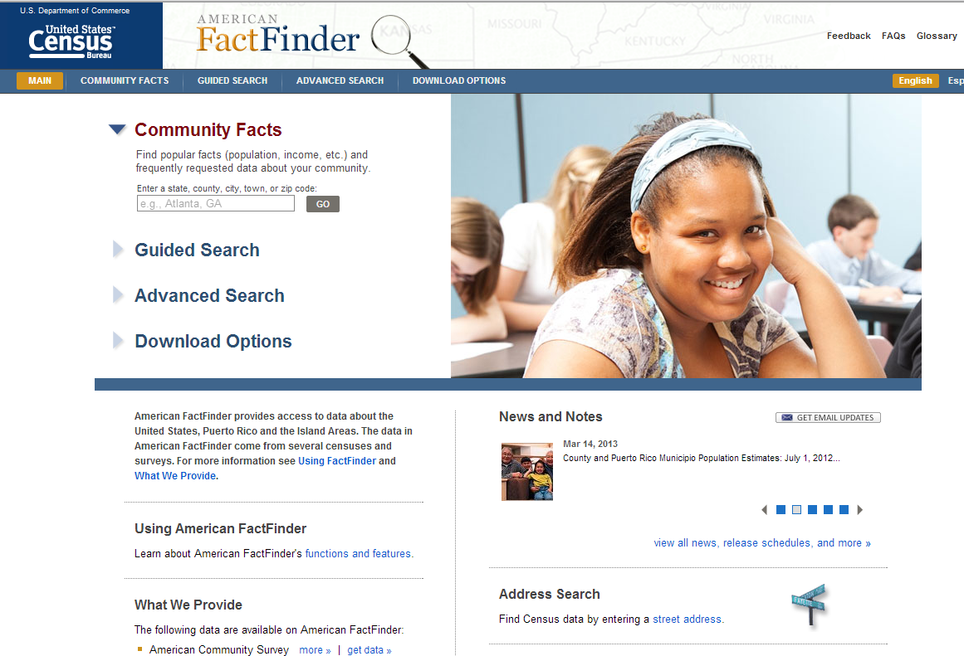
Relevant Statistics
Worldometers (www.worldometers.info/)
USA Right Now (www.usarightnow.com)
Population Pyramids of the World (populationpyramid.net/)
US Census (factfinder2.census.gov)

Slide 16
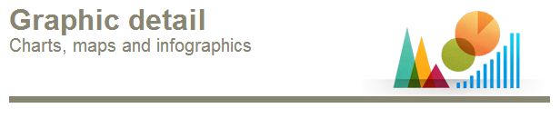
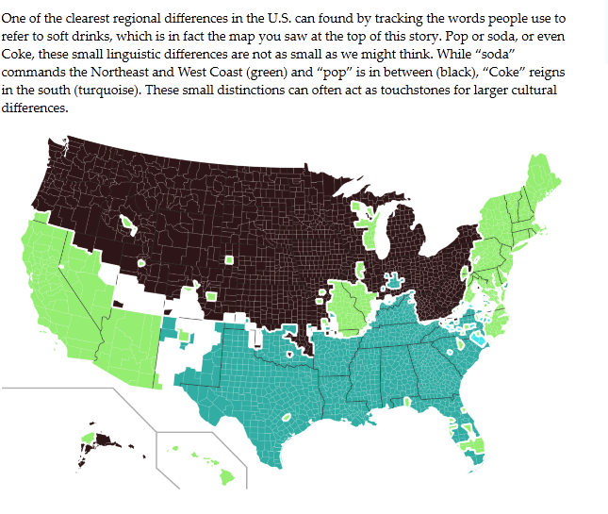
News Blogs & Quick Facts
TeachingWithData.org – Data in the News
U.S. Census Newsroom
Data360
The Economist: Graphic Detail Blog
Pew Research Center: Fact Tank
USA Today Snapshots
FiveThirtyEight (New York Times)
Use of terms “Soda,” “Pop,” and “Coke” from The Invisible Borders that Define American Culture, Data360
Notes:
About the Blog
FiveThirtyEight’s mission is to help New York Times readers cut through the clutter of an increasingly data-rich world. The blog, founded by Nate Silver in 2008, is devoted to rigorous, data-driven analysis of politics, polling, public affairs, sports, economics, science and culture. FiveThirtyEight also offers forecasts of upcoming presidential, congressional and gubernatorial elections, using proprietary statistical models. Read more »
Nate Silver is the author of The Signal and the Noise

Slide 17
Collections of Resources
Science Education Resource Center (Carleton College – pedagogical materials)
TeachingWithData.org
Social Science Data Analysis Network
ICPSR: Resources for Instructors
Data-driven Learning Guides (Short Exercises)
Modules
Tools (Social Science Variables Database, Bibliography, Crosstab Assignment Builder, SDA)

Slide 18
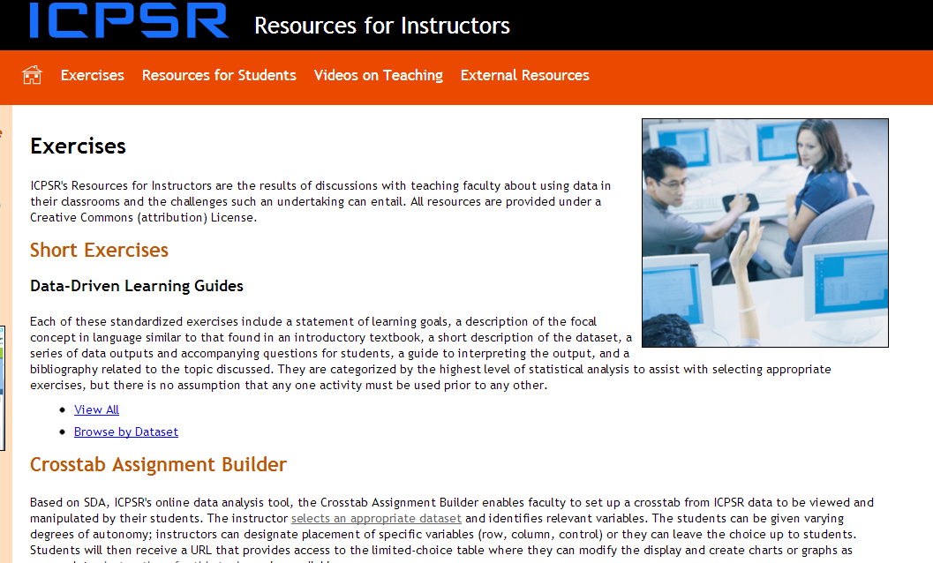
ICPSR Resources for Instructors

Slide 19
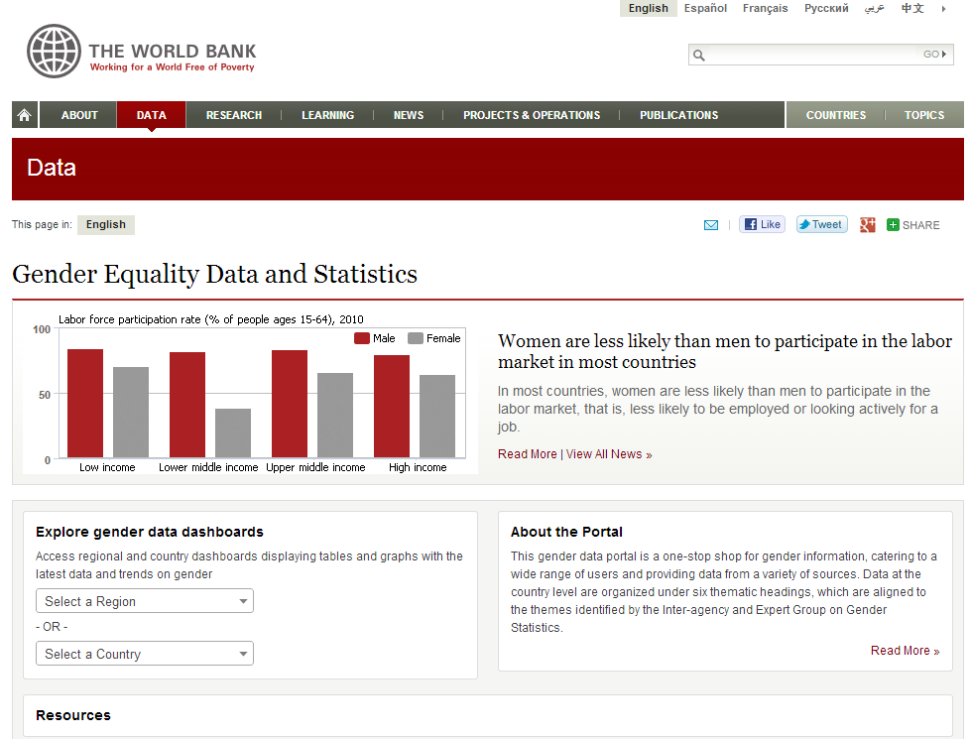
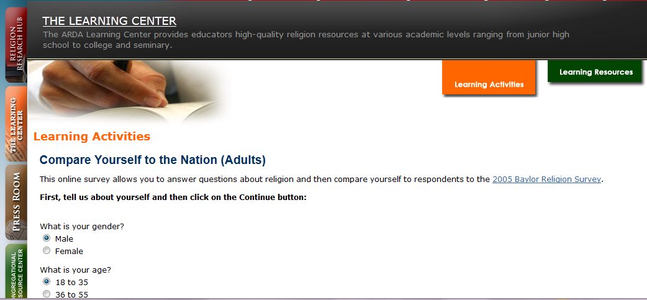
Other Cool Sites
Association of Religion Data Archives
World Bank

Slide 20
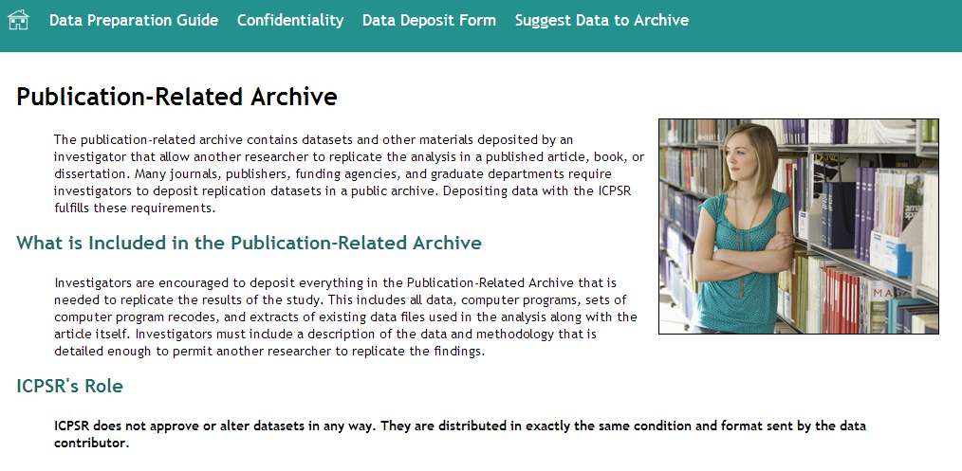
ICPSR Tools: Research Methods Examples
Find and Analyze Data
Online analysis
Find publications
Search/compare variables (operationalization, levels of measurement)
Crosstab Assignment Builder
Special modules (SETUPS, ICSC, EDRL)
Publication-related archive
Tutorials

Slide 21
Using Documentation
Codebooks
Methodological information
Cross-sectional study vs longitudinal/panel
Response rates
Evaluating for potential biases
Generalizability
Interviewer training manuals
Sample or time comparisons

Slide 22
Documentation (Con’t)
Question wording/question order
Objective and subjective measures (e.g., DDLG)
Validity/Reliability
Potential effects of missing data
“Qualitative” coding – open-ends, focus group data
Interesting data collections – MET and Chicago Neighborhoods study

Slide 23
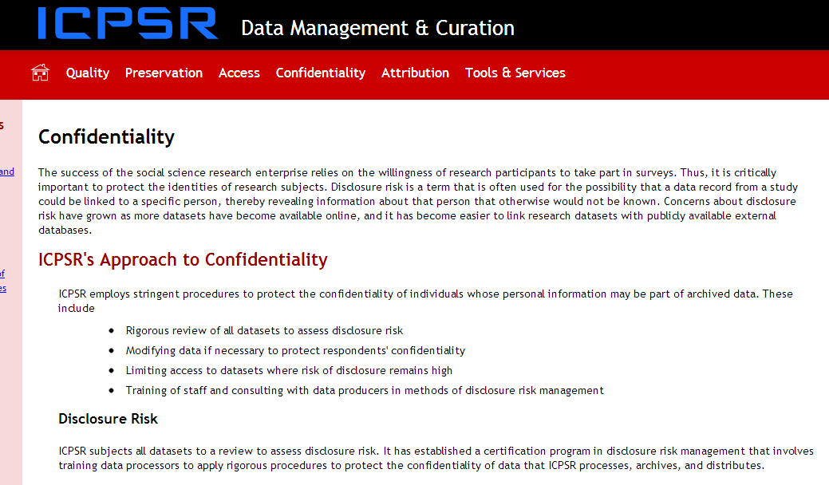
Discussions of Research Ethics
Sample Informed Consent agreement
Restricted-use data
Data management

Slide 24

Paper Competitions!

Slide 25
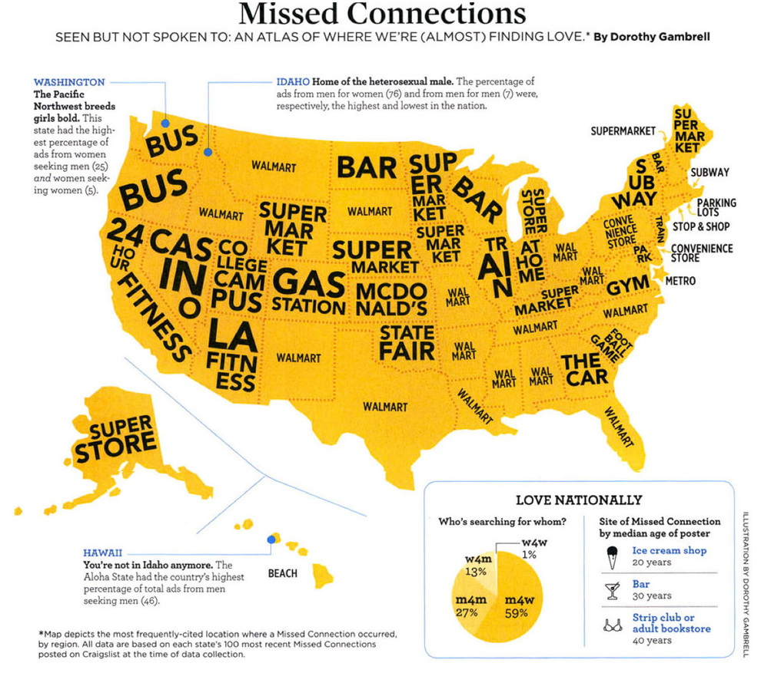
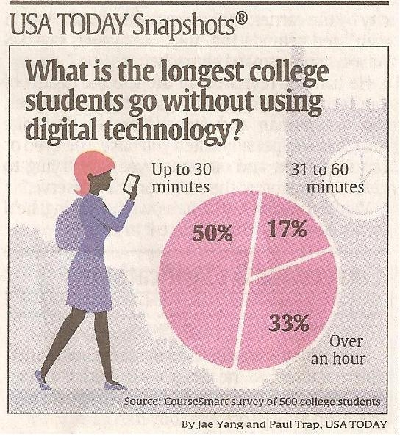
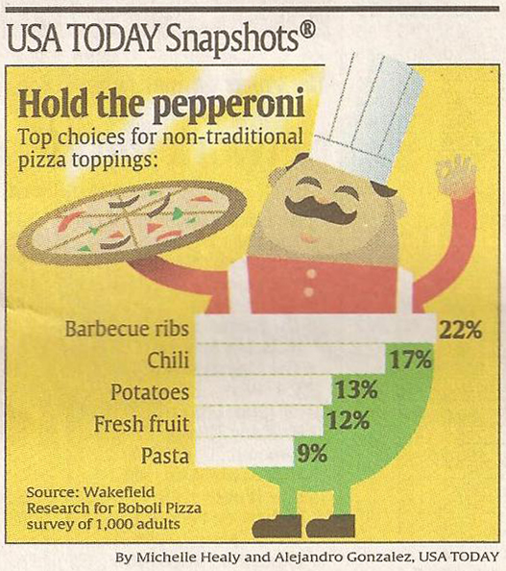
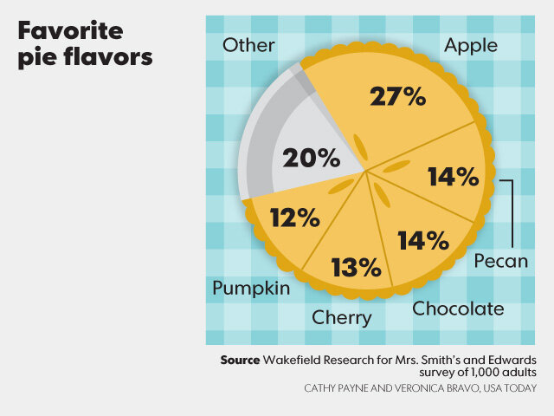
Data can be FUN!

Slide 26
Questions? Comments? Suggestions?
Lynette Hoelter: lhoelter@umich.edu

